Slide 1
Wildlife Mortality/Morbidity Event Reporting and Sampling
Forest, park, and protected area rangers

Slide 2
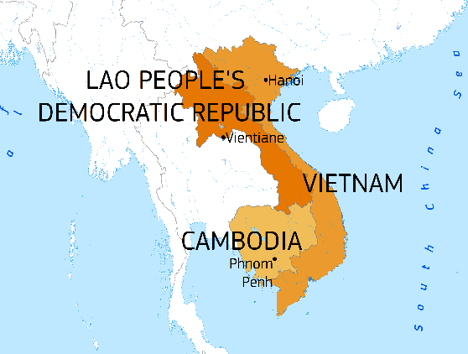
Outline
Objectives
Zoonotic diseases and your role
Examples of diseases and other causes of mortality/morbidity
How to report and investigate wildlife mortality/morbidity events
Personal Protective Equipment (PPE)
Sampling collection and transportation

Slide 3
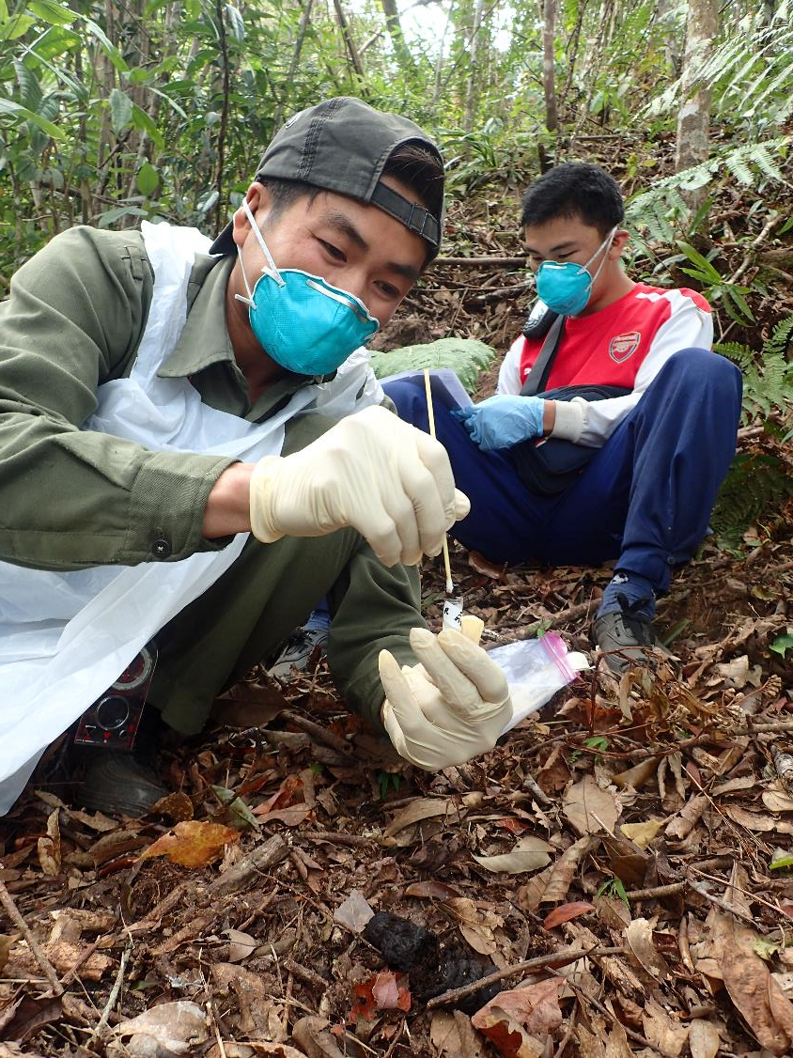
Ranger Training Objectives
Understand connections between wildlife-livestock-human health
Learn why surveillance and your role in the Network are important
Understand “pathogens” and basics of disease transmission
Become familiar with causes of mortality in wildlife
Learn the steps of wildlife mortality/morbidity event reporting
Understand how and why you must wear personal protective equipment (PPE) to protect yourself properly
Learn how to sample dead wildlife and record information
Learn how to pack/ship samples to lab correctly and safely

Slide 4










Wildlife Health Surveillance
Wildlife Conservation
Public Health
Important for...
Domestic Animal Health

Slide 5
Your role in wildlife mortality/morbidity event reporting and response
Rangers have the MOST IMPORTANT role in event detection!
First responders at the scene
If live animals involved, can aid in their survival
Can collect information and samples to determine WHY an animal died
To protect the health of wildlife, livestock, and humans, including rangers and their families!

Slide 6





What is a ZOONOTIC DISEASE?
A zoonotic disease is a disease that is caused by a pathogen transmitted from animals to humans.

Slide 7
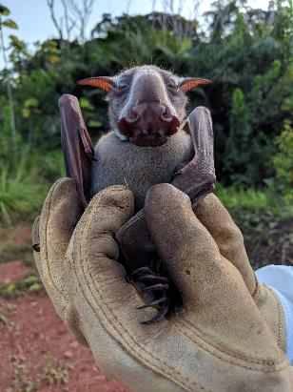
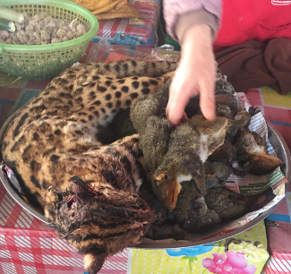
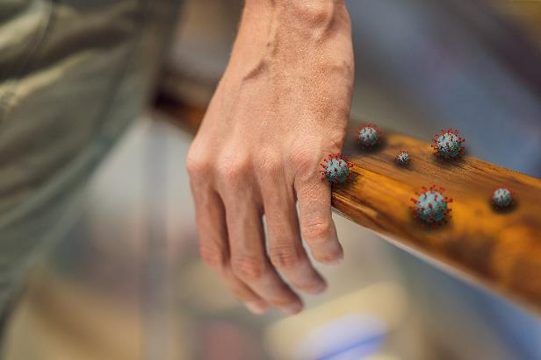
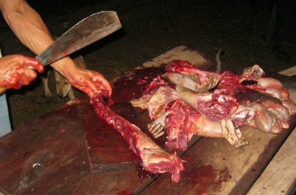
How can you get infected with a zoonotic pathogen?
Indirect contact (touching contaminated objects or surfaces)
Direct contact
Notes:
From respiratory transmission (breathing in a pathogen).
From direct contact, which can be from touching or butchering wildlife, or getting a bite from wildlife.
From consuming wildlife (birds, bats, rodents, any)
From biting insects/ticks which carry the pathogen from wildlife to people.
From contaminated environments, water, or food sources. Often from animal feces in the environment.

Slide 8
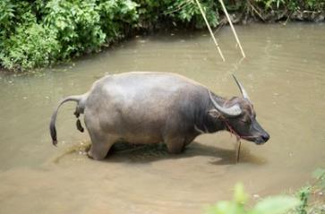
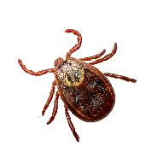
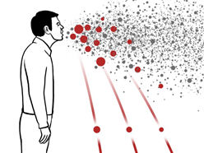
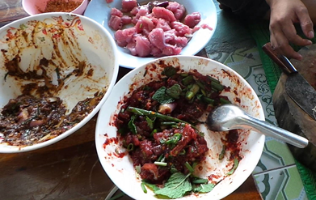
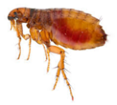
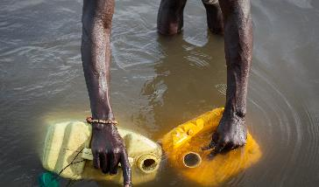
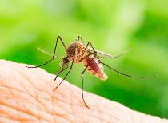
How can you get infected with a zoonotic pathogen?
Environmental contamination
Biting insects and ticks
Respiratory transmission
Consuming wildlife
Notes:
From respiratory transmission (breathing in a pathogen).
From direct contact, which can be from touching or butchering wildlife, or getting a bite from wildlife.
From consuming wildlife (birds, bats, rodents, any)
From biting insects/ticks which carry the pathogen from wildlife to people.
From contaminated environments, water, or food sources. Often from animal feces in the environment.

Slide 9
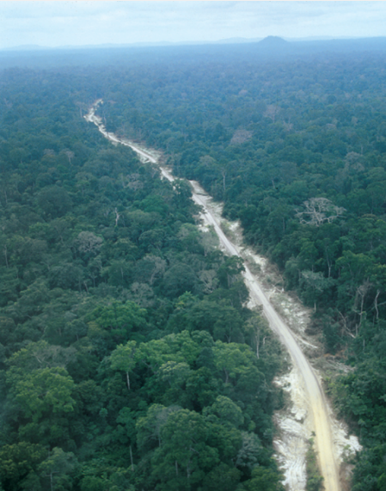
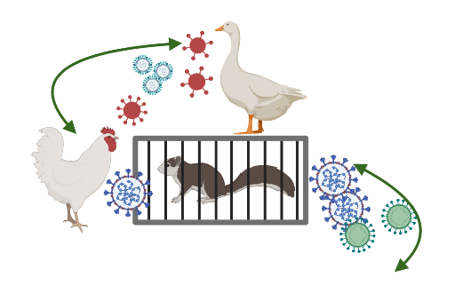
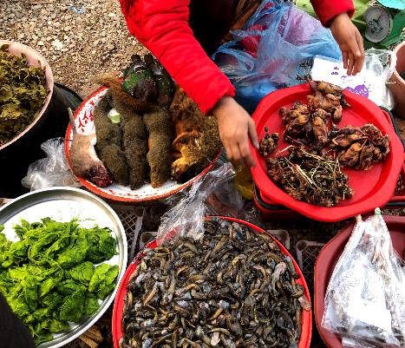
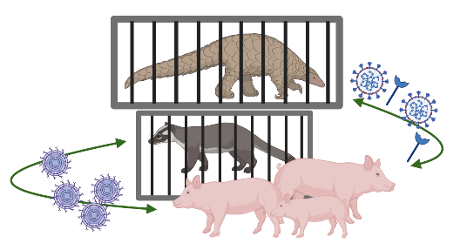
Pathogens naturally circulate in wildlife!
… But human behaviors and exploitation of nature drive pathogen “spillover”:
Wildlife trade & consumption
Land-use change & deforestation
Agriculture intensification
Urbanization
New photo
Notes:
Wildlife can transmit pathogens to live domestic animals (example – chickens) or to people in the market.

Slide 10
Some examples...

Slide 11
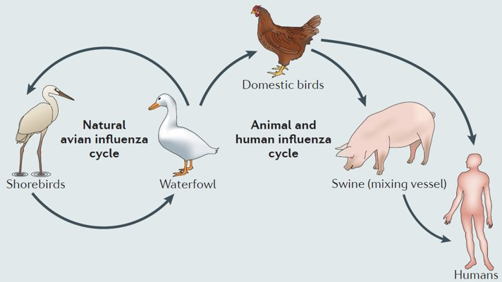
Avian Influenza Virus (e.g., H5N1)
Zoonotic virus
Occurs naturally in wild birds
Can cause illness and death in both domestic and wild birds
Can infect people and other mammals
Adapted from Shi et al 2014, Nature Microbiology Reviews
Notes:
Avian influenza is a zoonotic disease which has a natural reservoir in aquatic birds. Many of the strains have low pathogenicity, but can reassort into high path strains and infect poultry, humans, mammals, and other endangered birds. While AIV is studied in poultry in Cambodia, there is limited information about it in wild birds.
https://i.pinimg.com/originals/f3/71/1e/f3711ea43aefde5937bad22307e05578.png

Slide 12
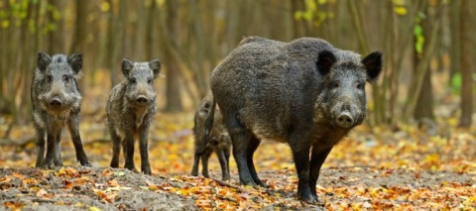
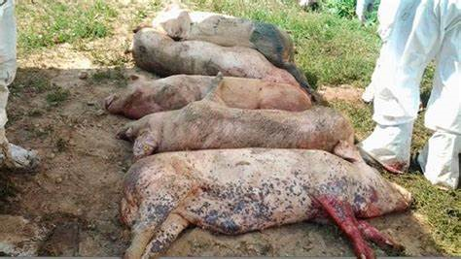

African Swine Fever
Highly contagious and fatal virus of swine. NOT ZOONOTIC.
Can cause significant economic loss for commercial pig production
Introduced to domestic pigs in Southeast Asia in early 2019
Detected in wild boar in Laos, Vietnam, Cambodia
Domestic and wild pigs infect one another
  biosecurity important for prevention
Notes:
It is not zoonotic but because infects domestic pigs it can have a large economic impact
https://cn.bing.com/images/search?view=detailV2&ccid=DjPZpNkg&id=4706EE84D47A5E92B9B118F81E7C8C89D05E5BE3&thid=OIP.DjPZpNkgt5irFI_614-80wHaDS&mediaurl=https%3A%2F%2Fwww.face.eu%2Fwp-content%2Fuploads%2F2018%2F02%2Fwild-boars.jpg&exph=213&expw=480&q=african+swine+fever+wild+boar&simid=608002312505000571&selectedindex=0&ajaxhist=0&vt=0
https://cn.bing.com/images/search?view=detailV2&id=44281DCDD75700BF6A0AA916EDB80E71578A29EB&thid=OIP.JZX8sA3h1arj5V4R-puBogHaHj&mediaurl=http%3A%2F%2Fwww.ipwatchdog.com%2Fwp-content%2Fuploads%2F2016%2F10%2Ffinancial-crisis-dollar-sign-no.jpg&exph=357&expw=350&q=financial+loss+symbol&selectedindex=9&ajaxhist=0&vt=0&eim=1,2,6
https://cn.bing.com/images/search?view=detailV2&id=3B54B4B935E401B49DED4369E35F4A6B80CAF4F3&thid=OIP.Zt4SaPUYM_uDcFObt1L9FQHaEK&mediaurl=https%3A%2F%2Fwww.pig333.com%2F3tres3_common%2Fart%2Fpig333%2F9390%2Fcarcasses-of-pigs-infected-with-asfv_77219.jpg%3Fw%3D650%26h%3D366%26ho%3D1&exph=366&expw=650&q=african+swine+fever&selectedindex=398&ajaxhist=0&vt=0&eim=1,2,6

Slide 13
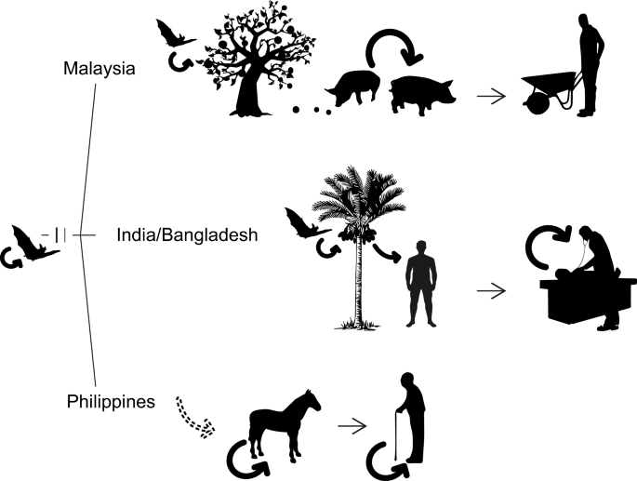
Nipah virus
Zoonotic virus
Reservoir – fruit bats
Transmission:
  Consuming food products (e.g., fruit, date palm sap) contaminated by bats
  Contact with infected animal secretions
  Human-to-human
Outbreaks: Malaysia, Singapore, India, Bangladesh, Philippines
Sun et al., 2018, Virologica Sinica
Notes:
Nipah is a zoonotic disease spread from bats to people via contaminated juices or domesticated animals such as pigs.

Slide 14
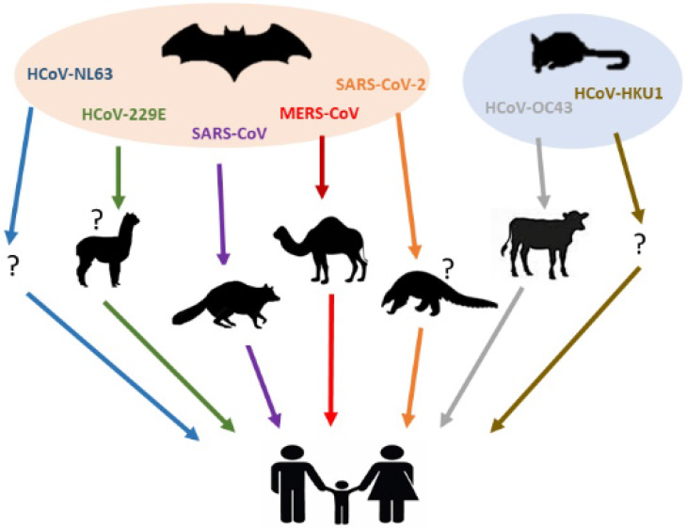
Coronaviruses
Found in many animal species; can be zoonotic
SARS-CoV: Asia
    linked to civets in wildlife trade
MERS: Middle East
    linked to contact with camels
SARS-CoV-2: worldwide
    potentially linked to wet market
Zi-Wei et al., 2020
Notes:
Nipah is a zoonotic disease spread from bats to people via contaminated juices or domesticated animals such as pigs.
Also opportunity to look for coronavirus.
https://static.toiimg.com/photo/msid-69673226/69673226.jpg

Slide 15
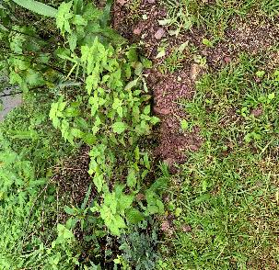
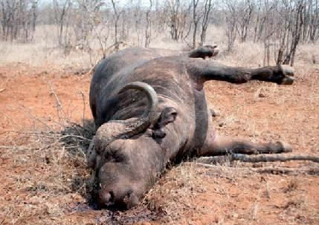

Anthrax
Bacteria (Bacillus anthracis) found normally in soil
If hot and dry, spores in soil can be eaten by ruminants (cattle/deer) when grazing
Humans infected by breathing in spores, eating food (e.g., meat) or drinking water contaminated with spores, or getting spores in open wounds
NEVER TOUCH AN ANIMAL SUSPICIOUS FOR ANTHRAX
  Signs – arched spine, bloated abdomen, blood from nose/mouth

Slide 16
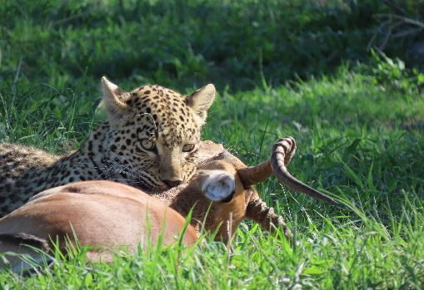
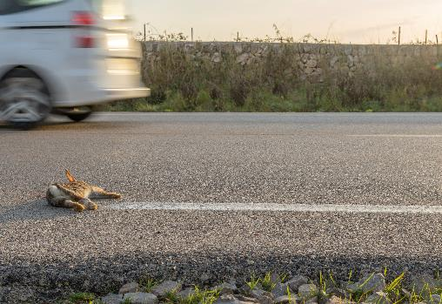
Other causes of wildlife morbidity & mortality
Natural causes: predator - prey
Hunting
  Trapping, snare, gunshot
Trauma
  Hit by car, power line collision
Poison / Toxin
  Pesticides (rodenticides, insecticides, herbicides)
  Algal blooms
Notes:
https://www.google.com/url?sa=i&url=https%3A%2F%2Fwww.boisestatepublicradio.org%2Fpost%2Fmass-die-east-idaho-birds-blamed-disease-and-poison&psig=AOvVaw2ACTeEz4jbGvBPkBnDuBuB&ust=1582821796267000&source=images&cd=vfe&ved=0CAIQjRxqFwoTCLjX9fnU7-cCFQAAAAAdAAAAABAF

Slide 17
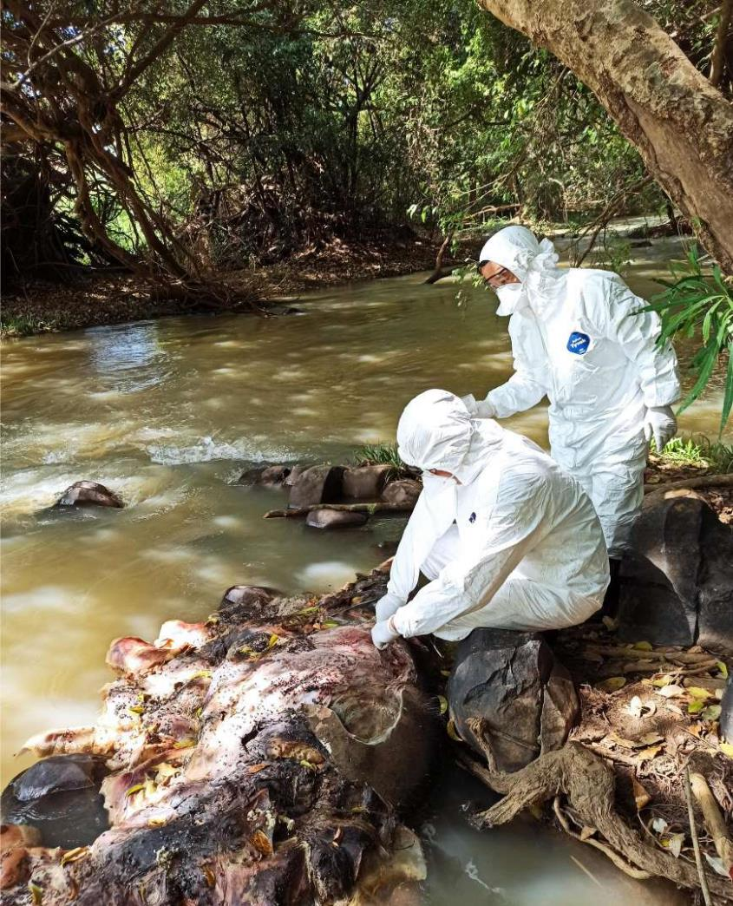
Components of Wildlife Health Surveillance
Detection of sick or dead wildlife
  Protected landscapes, national parks
  Wildlife rescue centers
  Confiscation events
  Wildlife trade markets
  Rural communities
Diagnosis
  Sampling, necropsy
  Diagnostic tests at laboratory
Reporting and response
  Reporting lines
  Data management (e.g., Wildlife Health Intelligence Platform)
Notes:
Wildlife Health Intelligence Platform – database where cases can entered and mapped and potential outbreak identified

Slide 18
How to report and investigate wildlife mortality/morbidity events
Forest, park, and protected area rangers

Slide 19
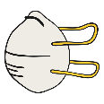





  Protect yourself first!
  Assess, search, and secure the area
What to do when you find a sick or dead wild animal?
  Record information on sick/dead wildlife (and report if required)
  Take pictures/video
  Obtain samples/carcass
  Keep samples/carcass cold and submit to laboratory
Notes:
After you decide the reporting and whether to sample or not, this is the flow of your activity.

Slide 20
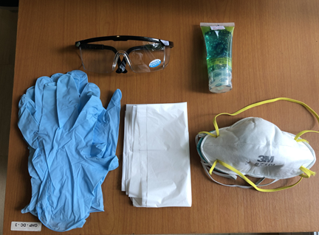

  Protect yourself first!
Personal Protective Equipment (PPE)
Equipment to protect yourself and others from physical, chemical, and biological hazards while working
Don PPE on BEFORE approaching the area
  No touching, poking animal without PPE!
PPE included in the field sampling kit
  Keep at least 1 kit in your backpack

Slide 21
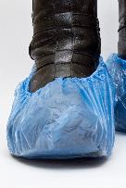
Personal Protective Equipment (PPE)
N95 mask
Apron
Gloves
Eye protection
Shoe covers

Slide 22
  Protect yourself first: Donning PPE
Find a clean and safe area for putting PPE on, away from the sick or dead wildlife.
Put on shoe covers if provided. If you don’t have shoe covers, use washable rubber boots.
Put on apron or other designated clothing if provided.
Put on N95 respirator mask. Make sure mask fits your face well and there are no gaps around the edges through which air and pathogens could enter.
Put on the safety goggles or face shield.
Put on the two layers of gloves. If a glove rips, replace it. Always wear two layers of gloves.

Slide 23
  Protect yourself first: Doffing PPE
Remove PPE in this order, away from sick or dead wildlife.
* If contaminated PPE cannot be burned at the site it can be placed in a biohazard bag, sealed, and brought back for safe disposal *
Disinfect outer gloves (e.g., with alcohol gel).
Remove and dispose of the apron or other protective clothing.
Remove shoe covers. If you used rubber boots, wash them thoroughly using a bleach solution.
Remove the outer gloves.
Remove eye protection. Reusable goggles can be disinfected.
Remove the mask without touching any part of your head.
Remove the inner gloves.
Wash your hands with disinfectant wipe or alcohol gel.

Slide 24
  Protect yourself first!
  Assess, search, and secure the area
What to do when you find a sick or dead wild animal?
  Record information on sick/dead wildlife (and report if required)
  Take pictures/video
  Obtain samples/carcass
  Keep samples/carcass cold and submit to laboratory
Notes:
After you decide the reporting and whether to sample or not, this is the flow of your activity.

Slide 25
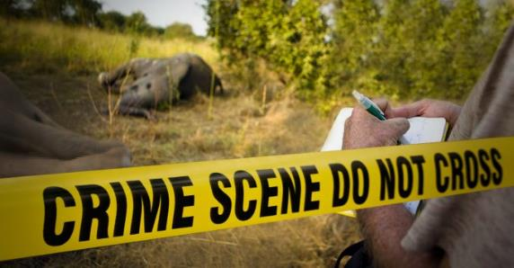
Assess, search, and secure the area
ASSESS
What are the hazards/dangers in approaching the area?
SEARCH
Make sure no other animals or people can enter the area
How many animals are involved (sick vs. dead)?
Can you see a cause of death? (e.g., snare)
If 2+ live animals involved, make sure someone remains at the site so potential interactions are prevented
SECURE
Check the surrounding area for other sick/dead animals

Slide 26
  Protect yourself first!
  Assess, search, and secure the area
What to do when you find a sick or dead wild animal?
  Record information on sick/dead wildlife (and report if required)
  Take pictures/video
  Obtain samples/carcass
  Keep samples/carcass cold and submit to laboratory
Notes:
After you decide the reporting and whether to sample or not, this is the flow of your activity.

Slide 27
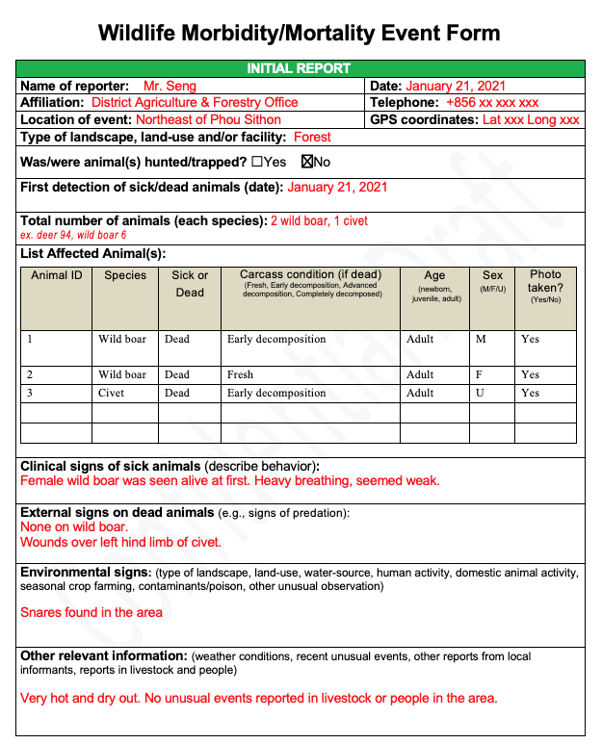
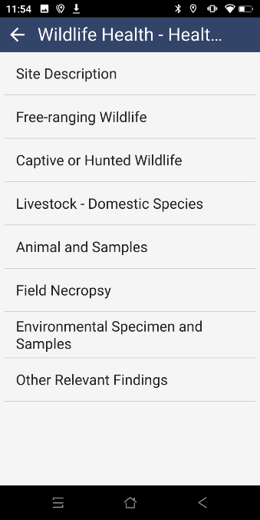
Record information
(on form or mobile device)

Slide 28
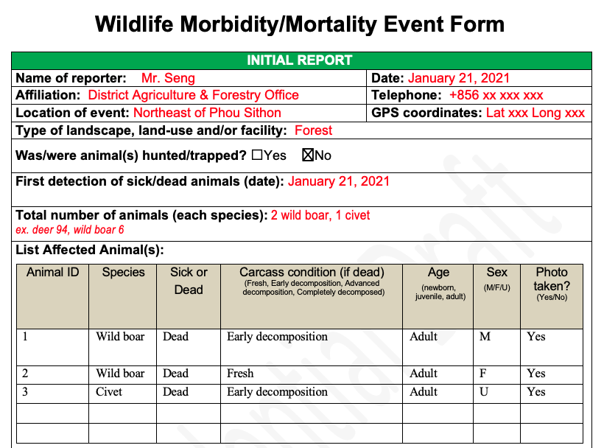

Slide 29
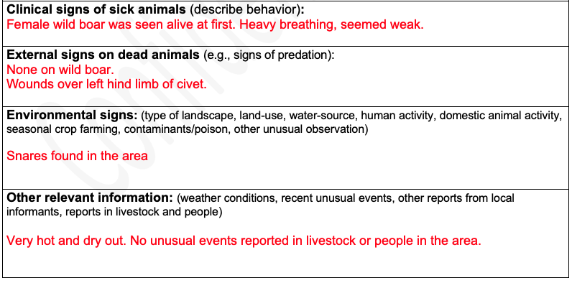

Slide 30
  Protect yourself first!
  Assess, search, and secure the area
What to do when you find a sick or dead wild animal?
  Record information on sick/dead wildlife (and report if required)
  Take pictures/video
  Obtain samples/carcass
  Keep samples/carcass cold and submit to laboratory
Notes:
After you decide the reporting and whether to sample or not, this is the flow of your activity.

Slide 31
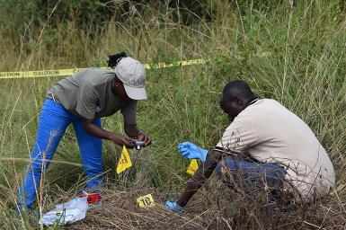
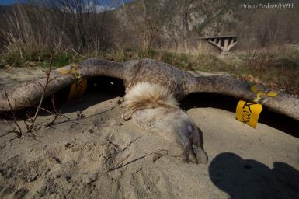
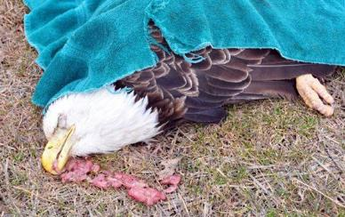
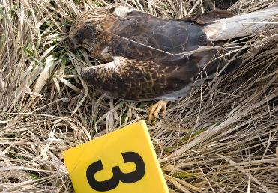
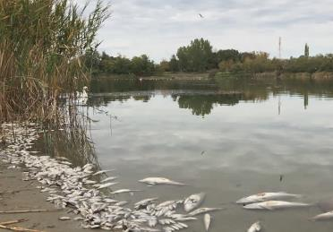
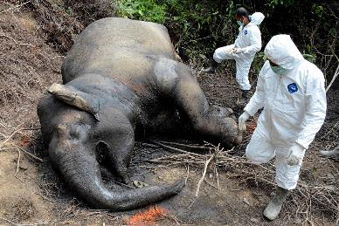
  Take pictures & video of sick/dead animals, their environment, any other unusual observation
DO NOT TOUCH OR MOVE anything at the scene until AFTER pictures are documented!
Notes:
https://theeye.co.ug/wcsi-training-scene-crime-officers-tackle-wildlife-crime-uganda/
https://www.4vultures.org/fighting-illegal-wildlife-poisoning-in-serbia/
https://spectator.sme.sk/c/20847071/poison-that-killed-birds-of-prey-found-in-hunters-house.html
https://www.shutterstock.com/video/clip-32411533-swan-poisoned-river-dead-fish-contaminated-water
https://news.cgtn.com/news/2019-11-23/Second-Sumatran-elephant-poisoned-and-dead-in-Indonesia-in-one-week-LQEVzaYyti/index.html

Slide 32
  Protect yourself first!
  Assess, search, and secure the area
What to do when you find a sick or dead wild animal?
  Record information on sick/dead wildlife (and report if required)
  Take pictures/video
  Obtain samples/carcass
  Keep samples/carcass cold and submit to laboratory
Notes:
After you decide the reporting and whether to sample or not, this is the flow of your activity.

Slide 33
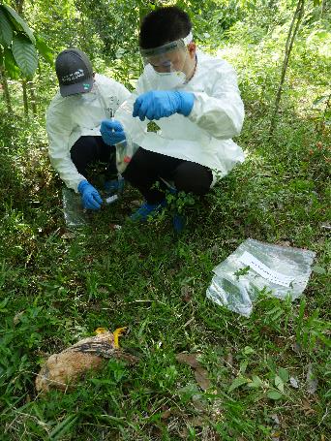
Obtain samples/carcass
Large Animal or patrol too long
Collect oral/rectal swabs
Collect oral/rectal swabs
Collect and package carcass safely and bring back to the station
Small Animal
(if feasible and permitted to collect)

Slide 34
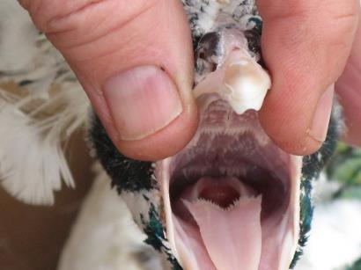
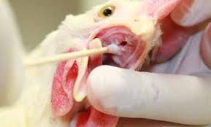
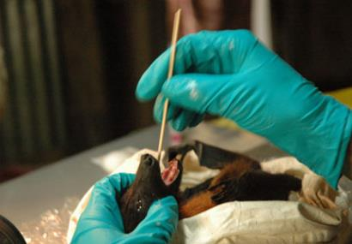
  Obtain samples/carcass
ORAL SWAB COLLECTION
  Open swab package without touching swab or shaft
  Swab inside mouth
            MAMMAL - Rub the swab against the back of the throat
            BIRD – Hold mouth open and rub swab around the tracheal opening and choanal slit
  Place swab in cryovial “O”
  Break or cut the end of the swab into the tube without touching the shaft
  Close the vial, put it back into the sampling kit
Notes:
https://birdtricksstore.com/blogs/birdtricks-blog/how-to-give-cpr-to-a-bird
https://www.hyline.com/technical-library

Slide 35
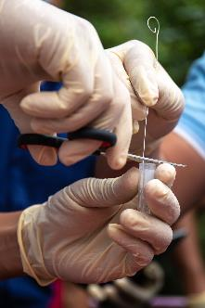
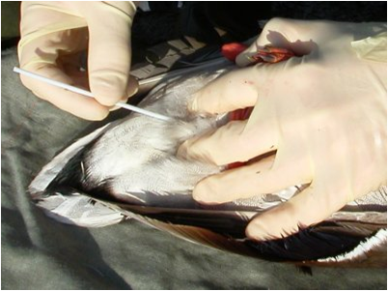
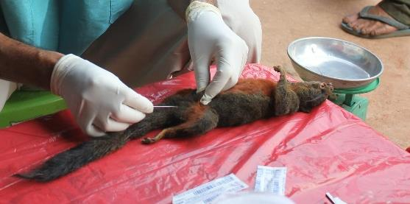
  Obtain samples/carcass
RECTAL/CLOACAL SWAB and FECES COLLECTION
  Open swab package without touching swab or shaft
  Swab rectum or cloaca
          MAMMAL– Insert the swab into the rectum swirling gently along the rectal wall
          BIRD – Insert the swab through the vent and into the cloaca, swirling gently
          FECES – feces can be placed directly into the vial if they are fresh and can be collected without contamination
  Place the swab in cryovial “R”
  Break or cut the end of the swab into the tube without touching the shaft
  Close the vial, put it back into the sampling kit
Notes:
https://twitter.com/jocelyn_tdv/status/641572099996426240

Slide 36
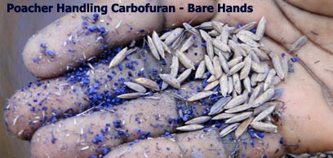
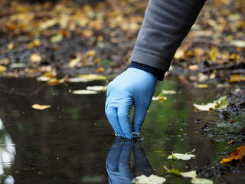


If poisoning is suspected, collect water, bait, or food item in the large blue tube
MAKE SURE TO WEAR GLOVES and EYE PROTECTION TO AVOID ANY CONTACT WITH SKIN OR EYES
Notes:
http://www.humanewildlife.org/wildlifepoison.html

Slide 37



  Obtain samples/carcass
CARCASS COLLECTION AND BAGGING
**Always wear PPE when collecting a carcass**
Invert a large plastic bag over your hand
Grasp the carcass in your hand, and invert the bag back over the carcass
Expel the excess air from the bag, away from your body
Seal the bag by tightly twisting and taping the top or zipping the bag closed
Repeat steps 1-4 to place the bagged carcass in a second plastic bag
Place this double-bagged carcass into a third and final bag
If multiple carcasses are found, they should be bagged individually!

Slide 38


  Obtain samples/carcass
SPECIMEN PACKAGING
Place all sample tubes in a small plastic bag with absorbent material (i.e. cotton wool, paper towels) and seal the bag
Place the sample bag and the double-bagged carcass, if collected, into the final bag
Add the Wildlife Mortality/Morbidity Event Form to this final plastic bag and seal the bag
** If contaminated PPE cannot be burned at the site it can be placed in a small plastic bag, sealed, and added to the final bag **

Slide 39














  Samples & carcass
  Samples only
1
1
1
2
Final bag

Slide 40
  Protect yourself first!
  Assess, search, and secure the area
What to do when you find a sick or dead wild animal?
  Record information on sick/dead wildlife (and report if required)
  Take pictures/video
  Obtain samples/carcass
  Keep samples/carcass cold and submit to laboratory
Notes:
After you decide the reporting and whether to sample or not, this is the flow of your activity.

Slide 41




Put samples in a freezer/cold box as soon as possible after collection and until transportation to the laboratory can be arranged
** Ensure the recipient of the specimen has been informed of the expected arrival time. Never send a specimen if you have not been able to inform someone.**
Use a hard-sided Styrofoam cooler lined with absorbent material and a thick plastic trash bag
Place the specimen package into the bag with ice packs or ice (ensuring that if the ice melts, water will not get inside the bag)
Seal and tape the plastic bag within the cooler
Close the cooler box and seal it with tape
Tape UN3373 label to the box
Label box with sender & recipient's information
Choose the fastest shipment option

Slide 42
Inform appropriate parties AND your supervisor!
CONTACT INFO:

Slide 43

Thank you for your contribution to wildlife health surveillance

